Slide 1

Akrivia Health / Global Minds Proteomics Update
Julie Segueni, PhD, Bioinformatics
Kevin Blighe, PhD, Bioinformatics
Corey Oravetz, CSM, Project Manager​
Shahraz Niwaz, MSc , Business Account Manager
10-Mar-2026

Slide 2
Agenda
01
Action Item Review
02
Team Updates
Open Q&A, Discussion Timelines
03
Month 2026
00

Slide 3
Meeting Minutes & Action Items

Slide 4
Minutes from 2026-Mar-10
Action Item Update
Julie: Confirmed the variance partitioning analysis remains on hold pending missing metadata for ~20 samples.
Joe: Reached out to Akrivia and plans to follow up, possibly finding some data himself.
Erin and Farzad: Shared their Akrivia onboarding which is partially complete — they can log in and access data, but additional guidance is needed before applying Julie's analysis to clinical readouts.
Joe: Highlighted that leadership changes at Akrivia are causing delays in prioritizing the team's data requests, also complicating the transfer of clinical data to Julie.
Bio Update
Julie: Shared her corrected figure from a prior slide — dementia vs. schizophrenic disorder contrast involves 60 DA proteins, not 79 — and introduced a GSEA-based pathway analysis across all disease contrasts.
Julie: Presented the summary heatmap showing normalized enrichment scores across contrasts; red indicates upregulation in the first-named disease, blue in the second, with key pathways including actin/cytoskeleton organization, RNA splicing, retinoid metabolic process, coagulation regulation, and immune response.
Julie: For the schizophrenic vs. bipolar contrast, zero DA proteins were identified, yet weak pathway trends emerged
Julie: Advised treating these results conservatively and noted they were excluded from the summary heatmap.
Julie: Reviewed the dot and ridge plots. The x-axis showing gene ratio within pathway, dot size reflects pathway gene count, and color indicates enrichment significance, with the p-value is the most important dimension.

Slide 5
Minutes from 2026-Mar-10
Bio Update
Erin: Raised a concern about whether coagulation pathway findings might reflect serum contamination rather than true plasma signal. Joe: Agreed to verify the sample type.
Team: Discussed the multiple peaks in ridge plots indicate subpopulations of proteins within the same pathway regulated at different magnitudes, potentially reflecting distinct functional roles or patient subgroups within a disease.
Team: Agreed on next analytical steps: extract proteins driving ridge plot peaks, plot raw abundances as heatmaps, color volcano plots by pathway membership, and use dementia as a reference group to show relative pathway expression across all diseases.
Julie: GSVA-style individual-level pathway scoring was proposed to assess whether subgroups exist within disease categories, complementing the current protein-level contrast analysis.
Corey: Flagged that the project budget will be exhausted before May; Alessandra agreed to add more funds and approved potential overage, with Corey planning a budget discussion with her on Friday.
Joe: Will confirm budget alignment with Alessandra on his side, ensuring transparency around the extended timeline and additional analysis scope.

Slide 6
Action Items
Action Items from 10-Mar-2026 Meeting
Julie: Extract proteins within the ridge plot peaks and plot them on raw abundance heatmaps. - IN PROGRESS
Julie: Color the volcano plot by identified pathway membership to show distribution of effect sizes per pathway. - IN PROGRESS
Julie: Provide new plots showing raw pathway-level abundances using dementia as a reference group across all diseases. - PAUSED
Joe: Check-in with Alessandra that the budget and spend are acceptable if the project timeline extends. - IN PROGRESS
Action Items from 24-Feb-2026 Meeting
• Julie: Pathway analysis from DAA results – COMPLETED, 09-Mar-2026
Action Items from 17-Feb-2026 Meeting
Julie: Julie to consider further analysis during the DAA that can statistically validate the absence of bias effects - IN PROGRESS
Action Items from 10-Feb-2026-Feb Meeting
Joe: Joe to reach out to Akrivia to get clarification about the 17 samples labeled as 'other' - IN PROGRESS
Joe: Provide Julie with any details about the normalization process that was applied to one of the data files - IN PROGRESS
Joe: Check on the progress of clinical data analysis and share any relevant co-morbidities or self-reported information that might be useful for differential analysis in next week's meeting – IN PROGRESS

Slide 7
Updates for SomaScan dataset - DAA

Slide 8
Correction on previous table
DA analysis results – General results
11k SOMAid from Somascan panel (mapping to 9,535 unique genes)
DA analysis per contrast among the diagnostic classes, adj.pval <=0.05 and |logFC| >= 0.5
Contrast | Dementia (n = 125 patients) | Depressive disorder (n = 152 patients) | Psychotic disorder (n = 36 patients) | Schizophrenic disorder (n = 54 patients)
Bipolar disorder (n = 81 patients) | 41 DA proteins | 0 DA protein | 6 DA proteins | 0 DA protein
Dementia (n = 125 patients) |  | 239 DA proteins | 81 DA proteins | 79 60 DA proteins
Depressive disorder (n = 152 patients) |  |  | 18 DA proteins | 0 DA protein
Psychotic disorder (n = 36 patients) |  |  |  | 2 DA proteins

Slide 9
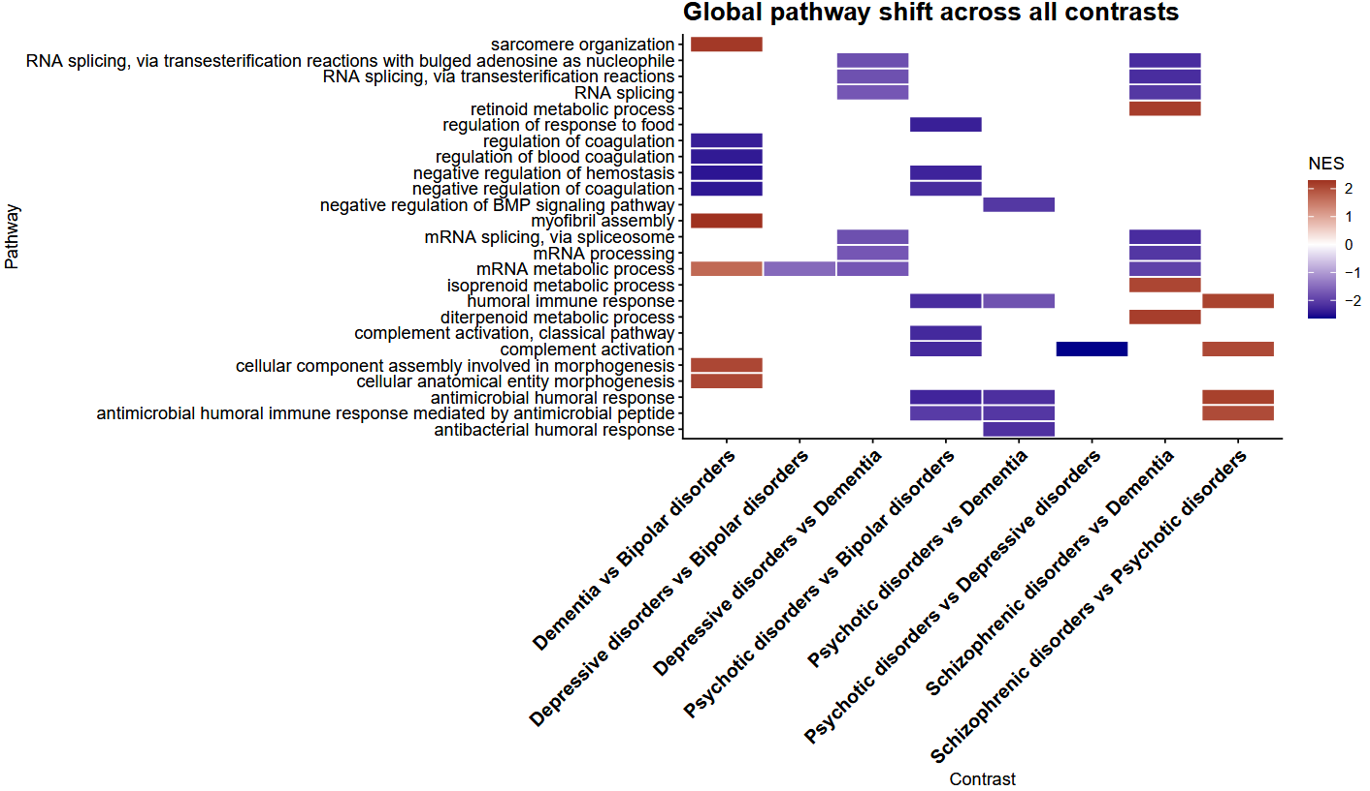
Summary of pathway analysis
Sarcomere organization is upregulated in Dementia
RNA splicing pathways are upregulated in Dementia
Retinoid metabolic process is upregulated in Schizophrenic disorders
Regulation of response to food is upregulated in Bipolar disorders
Regulation of coagulation pathways are upregulated in Bipolar disorders
Myofibril assembly is upregulated in Dementia
mRNA processing and splicing pathways are upregulated in Dementia (and one in Bipolar disorders)
Morphogenesis pathways are upregulated in Dementia
Immune response pathways are enriched in Dementia, Bipolar disorders and Schizophrenic disorders

Slide 10
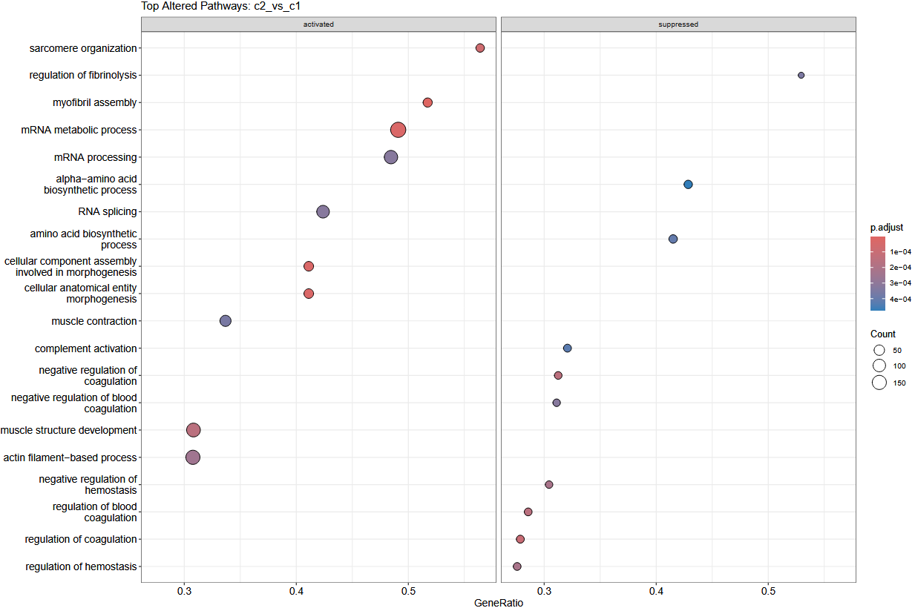
Pathway analysis of Dementia vs Bipolar disorders
41 DA proteins (adj p-val <= 0.05 and |logFC| >= 0.5)
14 proteins upregulated in Bipolar disorder, 27 upregulated in Dementia
Upregulated pathways in Dementia:
Sarcomere organization
Myofibril assembly
mRNA metabolic process
mRNA processing
RNA splicing
Cellular component assembly involved in morphogenesis
Cellular anatomical entity morphogenesis
Muscle contraction
Muscle structure development
Actin filament-based process
Upregulated pathways in Bipolar disorders:
Regulation of fibrinolysis
Alpha-amino acid biosynthetic process
Amino acid biosynthetic process
Complement activation
Negative regulation of coagulation
Negative regulation of blood coagulation
Negative regulation of homeostasis
Regulation of blood coagulation
Regulation of coagulation
Regulation of homeostasis

Slide 11
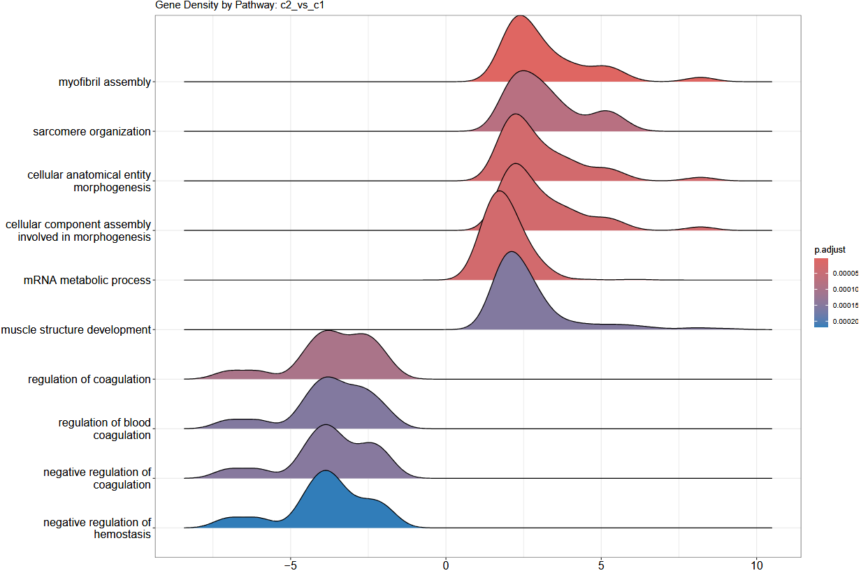
Pathway analysis of Dementia vs Bipolar disorders
41 DA proteins (adj p-val <= 0.05 and |logFC| >= 0.5)
14 proteins upregulated in Bipolar disorder, 27 upregulated in Dementia
Pathways where most proteins are upregulated in Dementia:
Myofibril assembly
Sarcomere organization
Cellular anatomical entity morphogenesis
Cellular component assembly involved in morphogenesis
mRNA metabolic process
Muscle structure development
Pathways where most proteins are upregulated in Bipolar disorder:
Regulation of coagulation
Regulation of blood coagulation
Negative regulation of coagulation
Negative regulation of hemostasis

Slide 12
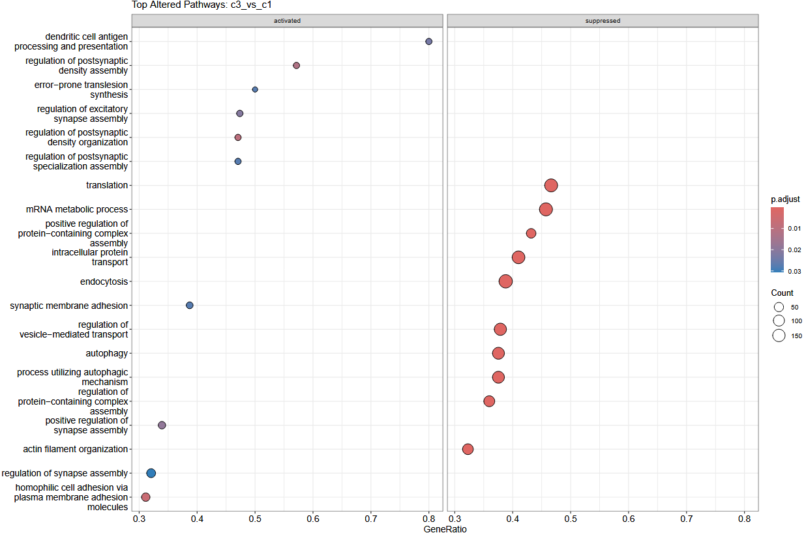
Pathway analysis of Depressive disorders vs Bipolar disorders
0 DA protein (adj p-val <= 0.05 and |logFC| >= 0.5)
Upregulated pathways in Depressive disorders:
Dendric cell antigen processing and presentation
Regulation of postsynaptic density assembly
Error-prone translesion synthesis
Regulation of excitatory synapse assembly
Regulation of postsynaptic specialization assembly
Synaptic membrane adhesion
Positive regulation of synapse assembly
Regulation of synapse assembly
Homophilic cell adhesion via plasma membrane adhesion molecules
Upregulated pathways in Bipolar disorders:
Translation
mRNA metabolic process
Positive regulation of protein-containing complex assembly
Intracellular protein transport
Endocytosis
Regulation of vesicle-mediated transport
Autophagy
Process utilizing autophagic mechanisms
Regulation of protein-complex assembly
Actin-filament organization

Slide 13
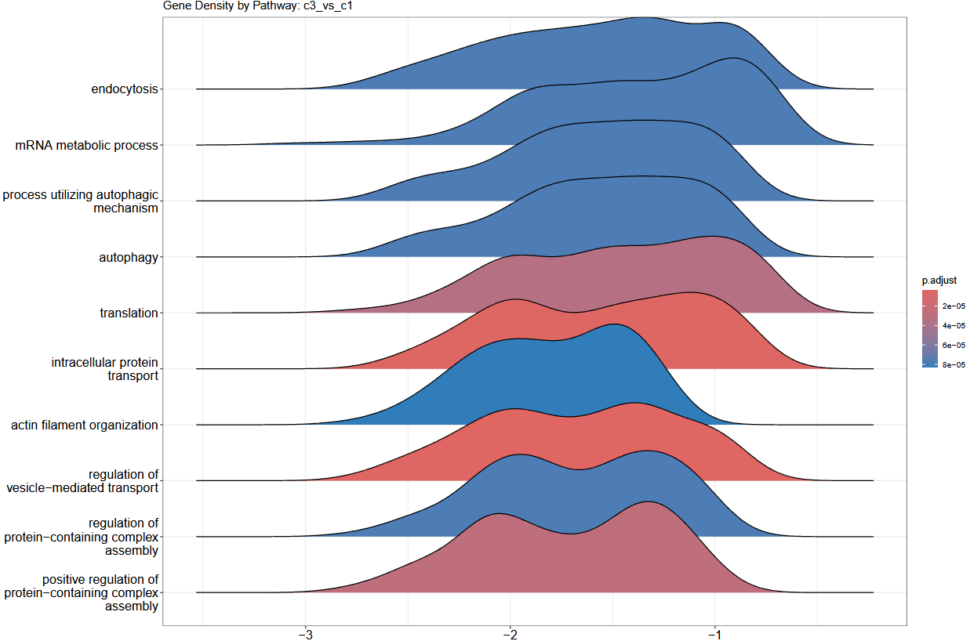
Pathway analysis of Depressive disorders vs Bipolar disorders
0 DA protein (adj p-val <= 0.05 and |logFC| >= 0.5)
Pathways where proteins seem to be upregulated in Bipolar disorders:
Endocytosis
mRNA metabolic process
Process utilizing autophagic mechanism
Autophagy
Translation
Intracellular protein transport
Actin filament organization
Regulation of vesicle-mediated transport
Regulation of protein-containing complex assembly
Positive regulation of protein-containing complex assembly

Slide 14
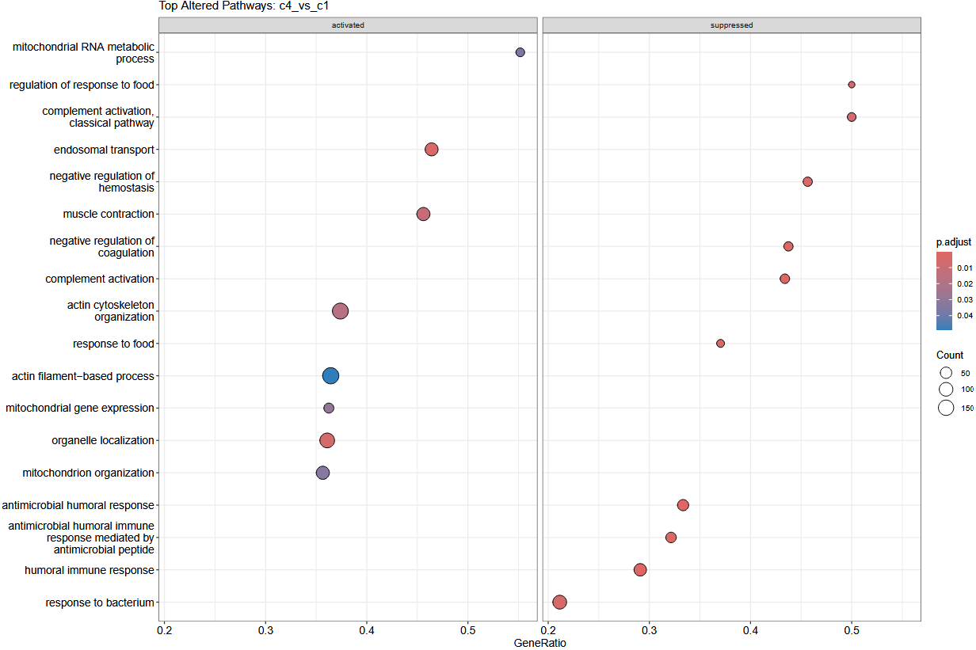
Pathway analysis of Psychotic disorders vs Bipolar disorders
6 DA proteins (adj p-val <= 0.05 and |logFC| >= 0.5)
2 proteins upregulated in Bipolar disorders and 4 proteins upregulated in Psychotic disorders
Upregulated pathways in Psychotic disorders:
Mitochondrial RNA metabolic process
Endosomal transport
Muscle contraction
Actin cytoskeleton organization
Actin filament-based process
Mitochondrial gene expression
Organelle localization
Mitochondrion organization
Upregulated pathways in Bipolar disorders:
Regulation of response to food
Complement activation, classical pathway
Negative regulation of hemostasis
Complement activation
Response to food
Antimicrobial humoral response
Antimicrobial humoral immune response mediated by antimicrobial peptide
Humoral immune response
Response to bacterium

Slide 15
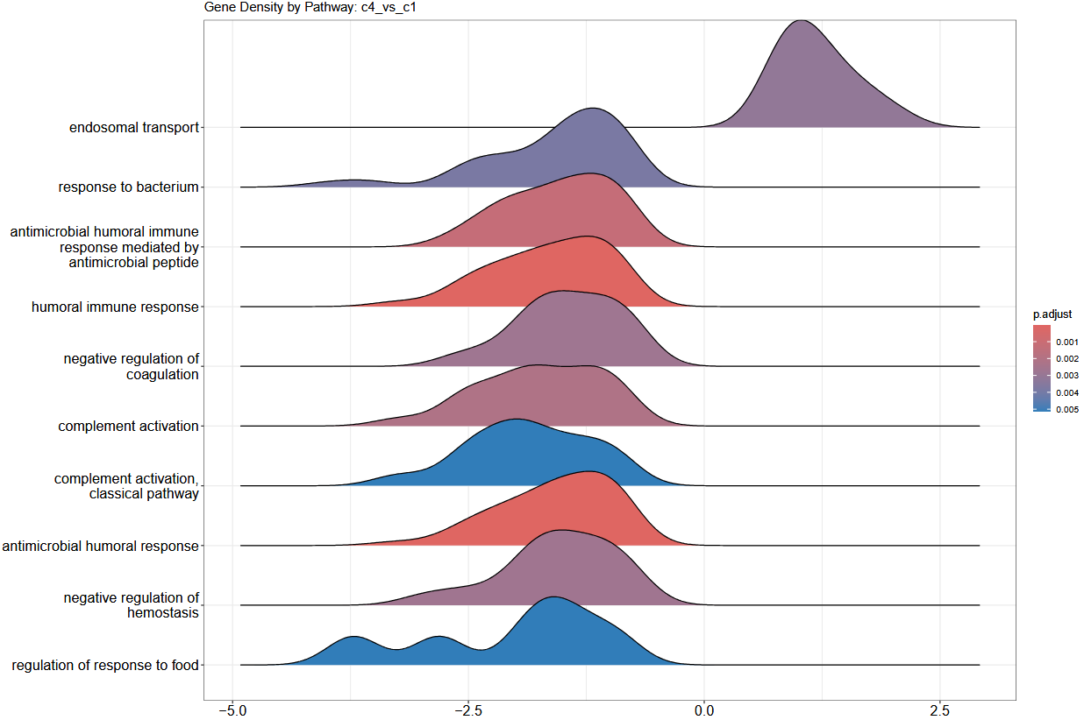
Pathway analysis of Psychotic disorders vs Bipolar disorders
6 DA proteins (adj p-val <= 0.05 and |logFC| >= 0.5)
2 proteins upregulated in Bipolar disorders and 4 proteins upregulated in Psychotic disorders
Pathway where most proteins seem to be upregulated in Psychotic disorders:
Endosomal transport
Pathways where most proteins seem to be upregulated in Bipolar disorders

Slide 16
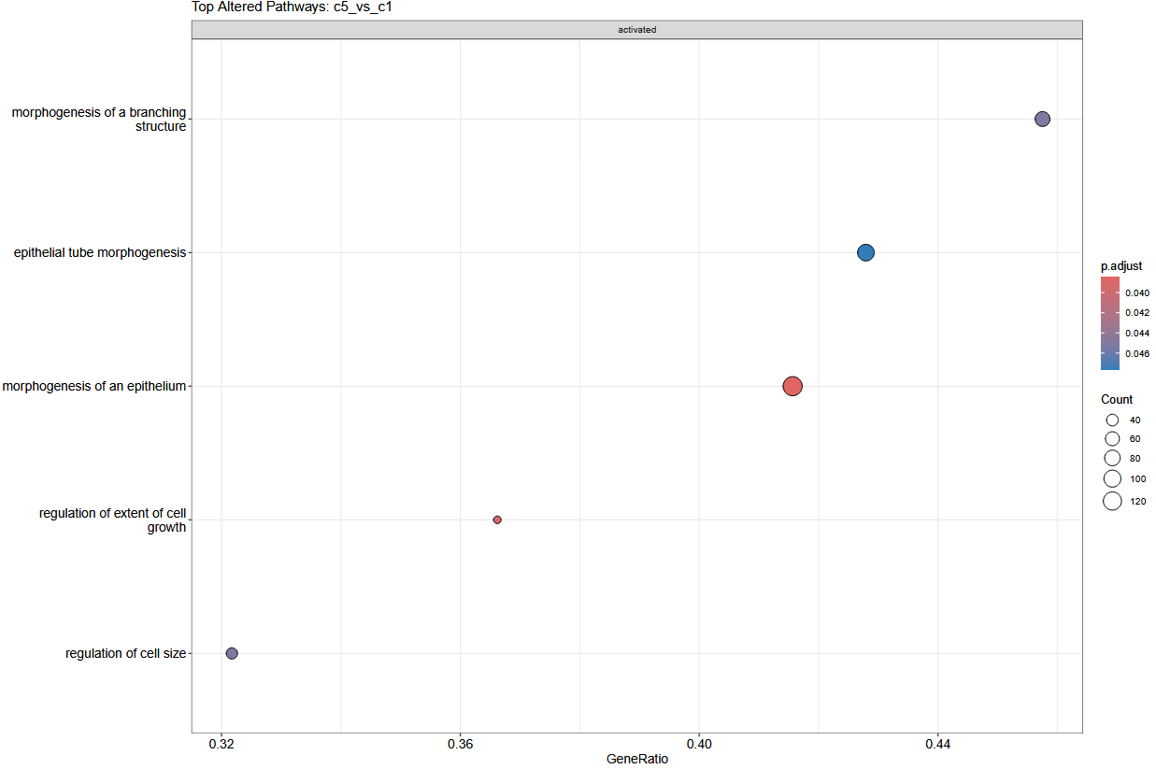
Pathway analysis of Schizophrenic disorders vs Bipolar disorders
0 DA protein (adj p-val <= 0.05 and |logFC| >= 0.5)
Upregulated pathways in Schizophrenic disorders:
Morphogenesis of a branching structure
Epithelial tube morphogenesis
Morphogenesis of an epithelium
Regulation of extent of cell growth
Regulation of cell size

Slide 17
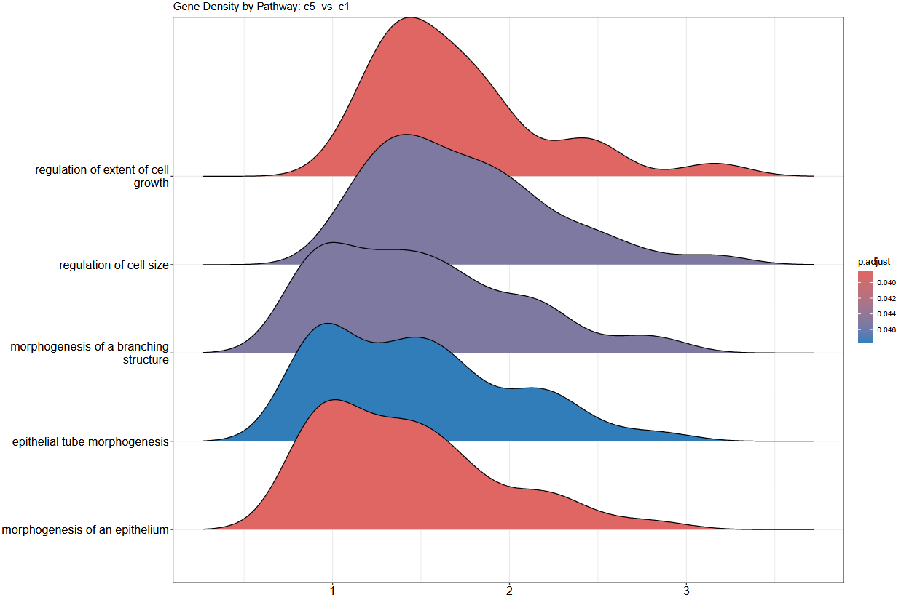
Pathway analysis of Schizophrenic disorders vs Bipolar disorders
0 DA protein (adj p-val <= 0.05 and |logFC| >= 0.5)
Pathways where most proteins seem to be upregulated in Schizophrenic disorders:
Regulation of extent of cell growth
Regulation of cell size
Morphogenesis of a branching structure
Epithelial tube morphogenesis
Morphogenesis of an epithelium

Slide 18
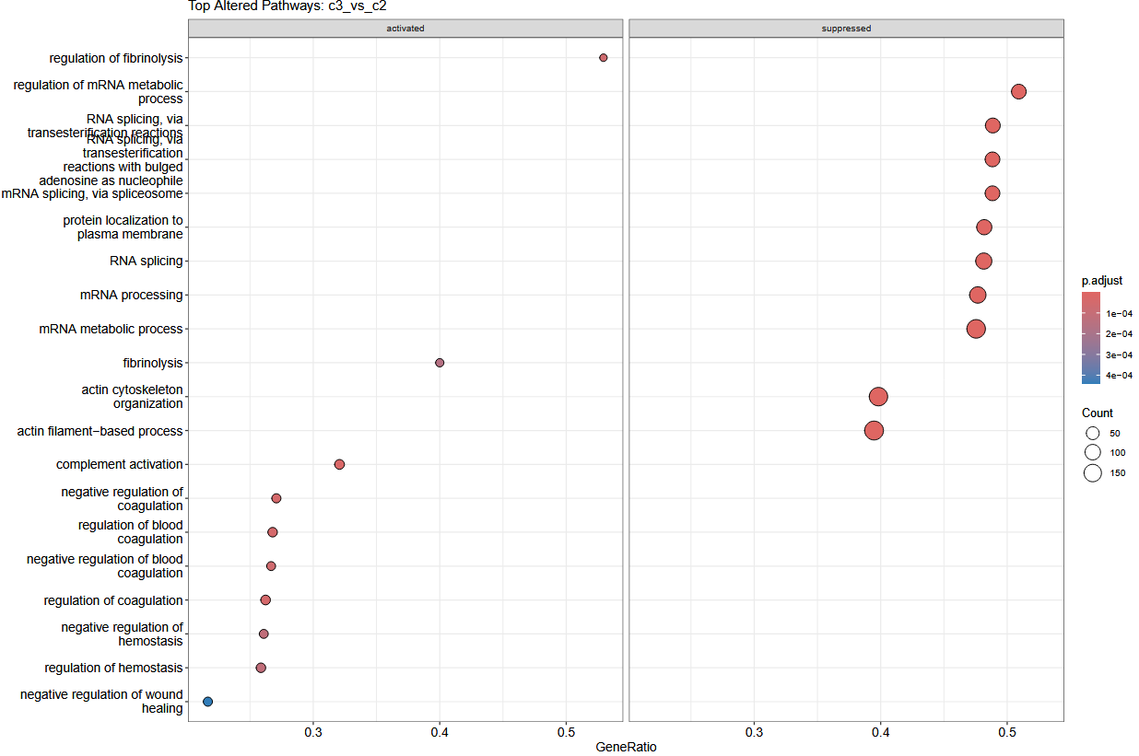
Pathway analysis of Depressive disorders vs Dementia
239 DA proteins (adj p-val <= 0.05 and |logFC| >= 0.5)
233 proteins upregulated in Dementia and 6 proteins upregulated in Depressive disorders
Upregulated pathways in Depressive disorders:
Regulation of fibrinolysis
Fibrinolysis
Complement activation
Negative regulation of coagulation
Regulation of blood coagulation
Negative regulation of blood coagulation
Regulation of coagulation
Negative regulation of hemostasis
Regulation of hemostasis
Negative regulation of wound healing
Upregulated pathways in Dementia:
Regulation of mRNA metabolic process
RNA splicing via transesterification reactions
RNA splicing via transesterification reactions with bulged adenosine as nucleophile
mRNA splicing via spliceosome
Protein localization to plasma membrane
RNA splicing
mRNA processing
Actin cytoskeleton organization
Actin filament-based process

Slide 19
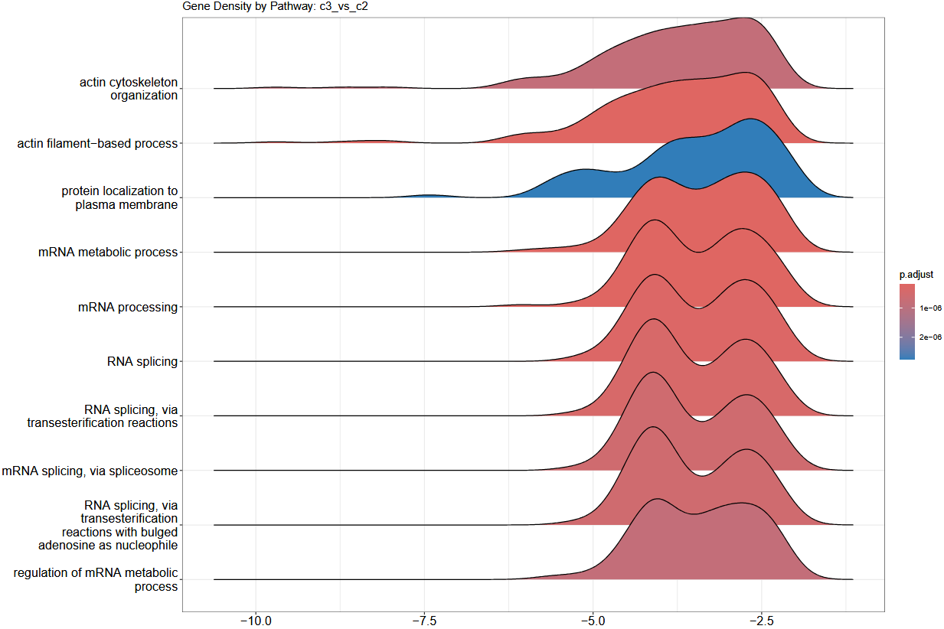
Pathway analysis of Depressive disorders vs Dementia
239 DA proteins (adj p-val <= 0.05 and |logFC| >= 0.5)
233 proteins upregulated in Dementia and 6 proteins upregulated in Depressive disorders
Pathways where most proteins are upregulated in Dementia:
Actin cytoskeleton organization
Actin filament-based process
Protein localization to plasma membrane
mRNA metabolic process (2 peaks)
mRNA processing (2 peaks)
RNA splicing (2 peaks)
RNA splicing via transesterification reactions (2 peaks)
mRNA splicing via spliceosome (2 peaks)
RNA splicing via transesterification reactions with bulged adenosine as nucleophile (2 peaks)
Regulation of mRNA metabolic process (2 peaks)
The 2 peaks indicate that 2 subgroups of proteins in the pathway have different logFC between the diseases, with 1 subgroup being more upregulated that the other.

Slide 20
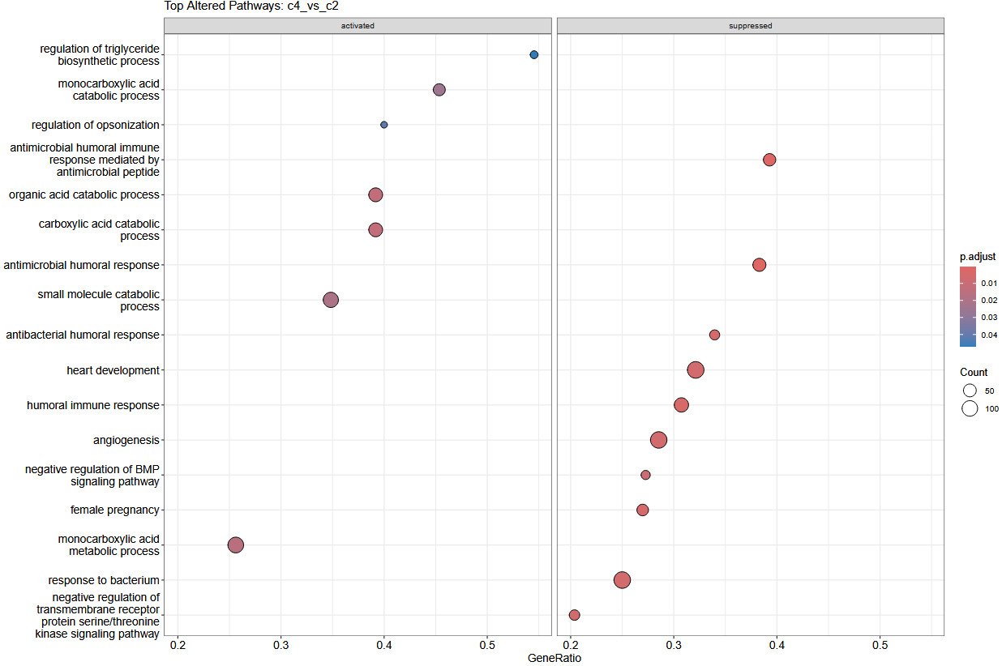
Pathway analysis of Psychotic disorders vs Dementia
81 DA proteins (adj p-val <= 0.05 and |logFC| >= 0.5)
57 proteins upregulated in Dementia and 24 proteins upregulated in Psychotic disorders
Upregulated pathways in Psychotic disorders:
Regulation of triglyceride biosynthetic process
Monocarboxylic acid catabolic process
Regulation of opsonization
Organic acid catabolic process
Carboxylic acid catabolic process
Small molecule catabolic process
Monocarboxylic acid metabolic process
Upregulated pathways in Dementia:
Antimicrobial humoral immune response mediated by antimicrobial peptide
Antimicrobial humoral response
Heart development
Humoral immune response
Angiogenesis
Negative regulation of BMP signaling pathway
Female pregnancy
Response to bacterium
Negative regulation of transmembrane receptor protein serine/threonine kinase signaling pathway

Slide 21
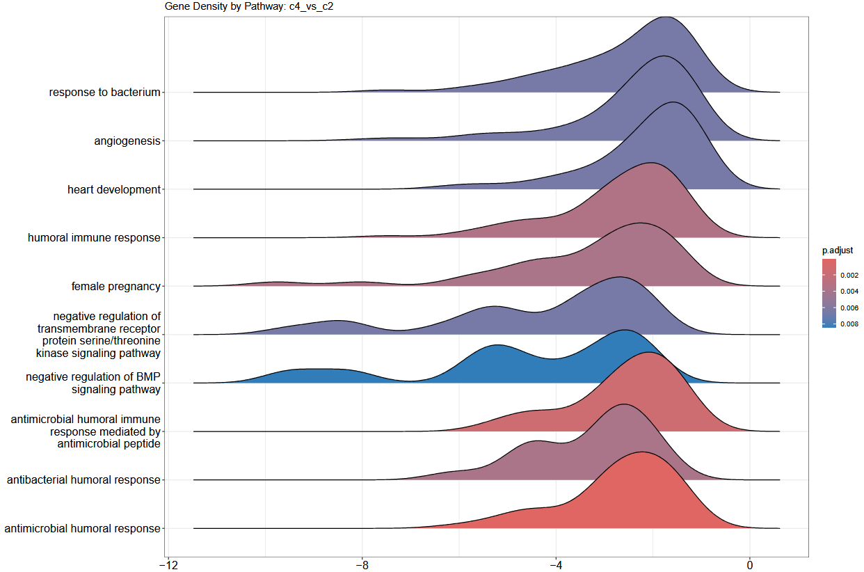
Pathway analysis of Psychotic disorders vs Dementia
81 DA proteins (adj p-val <= 0.05 and |logFC| >= 0.5)
57 proteins upregulated in Dementia and 24 proteins upregulated in Psychotic disorders
Pathways where most proteins are upregulated in Dementia:
Response to bacterium
Angiogenesis
Heart development
Humoral immune response (2 peaks?)
Female pregnancy (2 peaks)
Negative regulation of transmembrane receptor protein serine/threonine kinase signaling pathway (3 peaks with extreme outliers)
Negative regulation of BMP signaling pathway (3 peaks with extreme outliers)
Antimicrobial humoral immune response mediated by antimicrobial peptide (2 peaks?)
Antibacterial humoral response (2 peaks?)
Antimicrobial humoral response (2 peaks?)

Slide 22
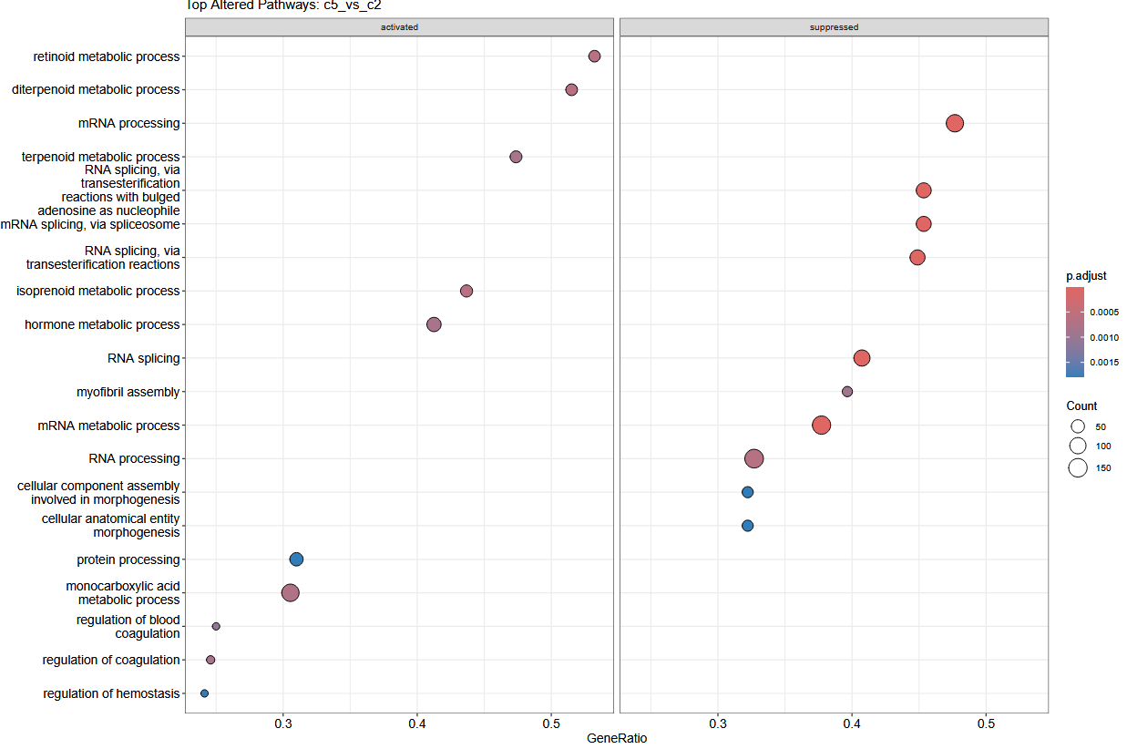
Pathway analysis of Schizophrenic disorders vs Dementia
60 DA proteins (adj p-val <= 0.05 and |logFC| >= 0.5)
32 proteins upregulated in Dementia and 28 proteins upregulated in Schizophrenic disorders
Upregulated pathways in Schizophrenic disorders:
Retinoid metabolic process
Diterpenoid metabolic process
Terpenoid metabolic process
Isoprenoid metabolic process
Protein processing
Monocarboxylic acid metabolic process
Regulation of blood coagulation
Regulation of coagulation
Regulation of hemostasis
Upregulated pathways in Dementia:
mRNA processing
RNA splicing via transesterification reactions with bulged adenosine as nucleophile
mRNA splicing via spliceosome
RNA splicing via transesterification process
RNA splicing
Myofibril assembly
mRNA metabolic process
RNA processing
Cellular component assembly involved in morphogenesis
Cellular anatomical entity morphogenesis

Slide 23
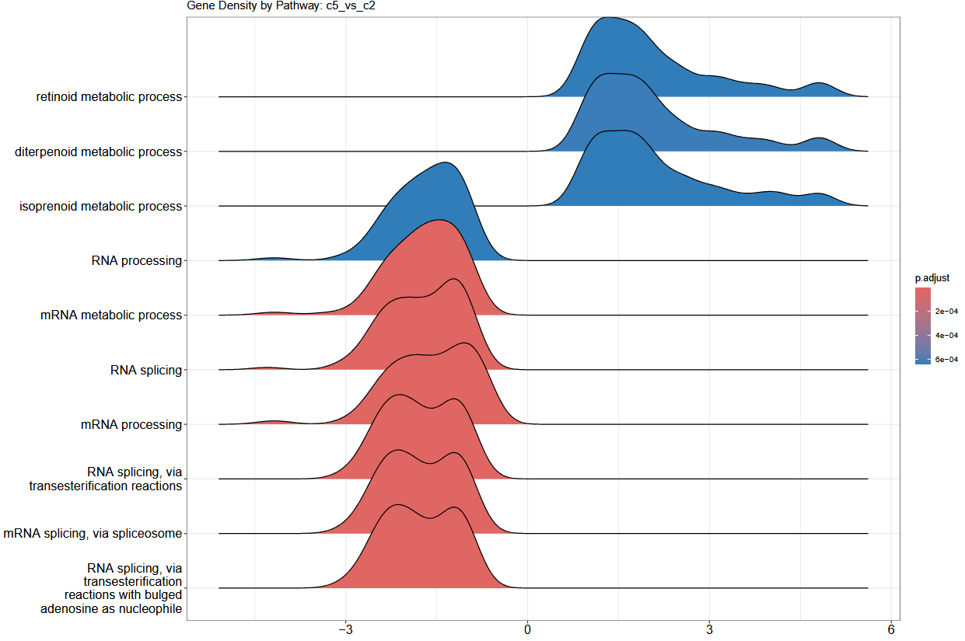
Pathway analysis of Schizophrenic disorders vs Dementia
60 DA proteins (adj p-val <= 0.05 and |logFC| >= 0.5)
32 proteins upregulated in Dementia and 28 proteins upregulated in Schizophrenic disorders
Pathways where most proteins are upregulated in Schizophrenic disorders:
Retinoid metabolic process
Diterpenoid metabolic process
Isoprenoid metabolic process
Pathways where most proteins are upregulated in Dementia:
RNA processing
mRNA metabolic process
RNA splicing (2 peaks)
mRNA processing (2 peaks)
RNA splicing via transesterification reactions (2 peaks)
mRNA splicing via spliceosome
RNA splicing via transesterification reactions with bulged adenosine as nucleophile (2 peaks)

Slide 24
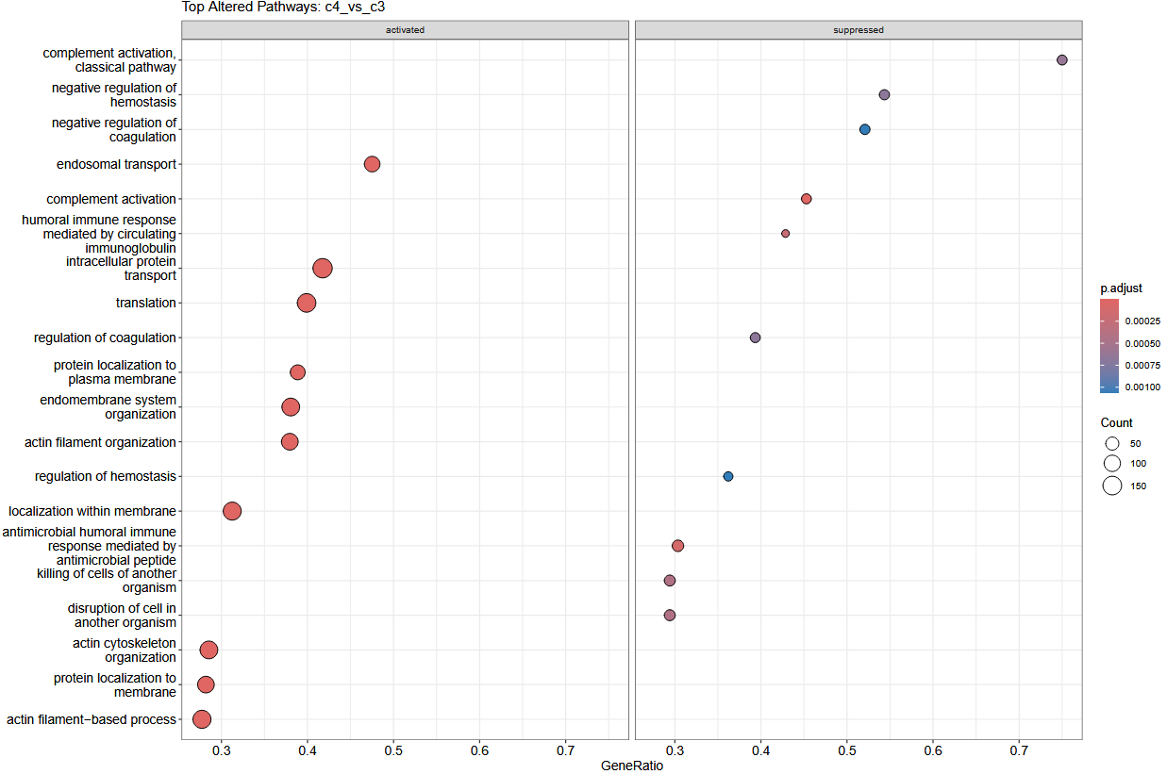
Pathway analysis of Psychotic disorders vs Depressive disorders
18 DA proteins (adj p-val <= 0.05 and |logFC| >= 0.5)
2 proteins upregulated in Depressive disorders and 16 proteins upregulated in Psychotic disorders
Upregulated pathways in Psychotic disorders:
Endosomal transport
Intracellular protein transport
Translation
Protein localization to plasma membrane
Endomembrane system organization
Localization within membrane
Actin cytoskeleton organization
Protein localization to membrane
Actin filament-based process
Upregulated pathways in Depressive disorders:
Complement activation, classical pathway
Negative regulation of homeostasis
Negative regulation of coagulation
Complement activation
Humoral immune response mediated by circulating immunoglobulin
Regulation of coagulation
Regulation of hemostasis
Antimicrobial humoral immune response mediated by antimicrobial peptide
Killing of cells of another organism
Disruption of cell in another organization

Slide 25
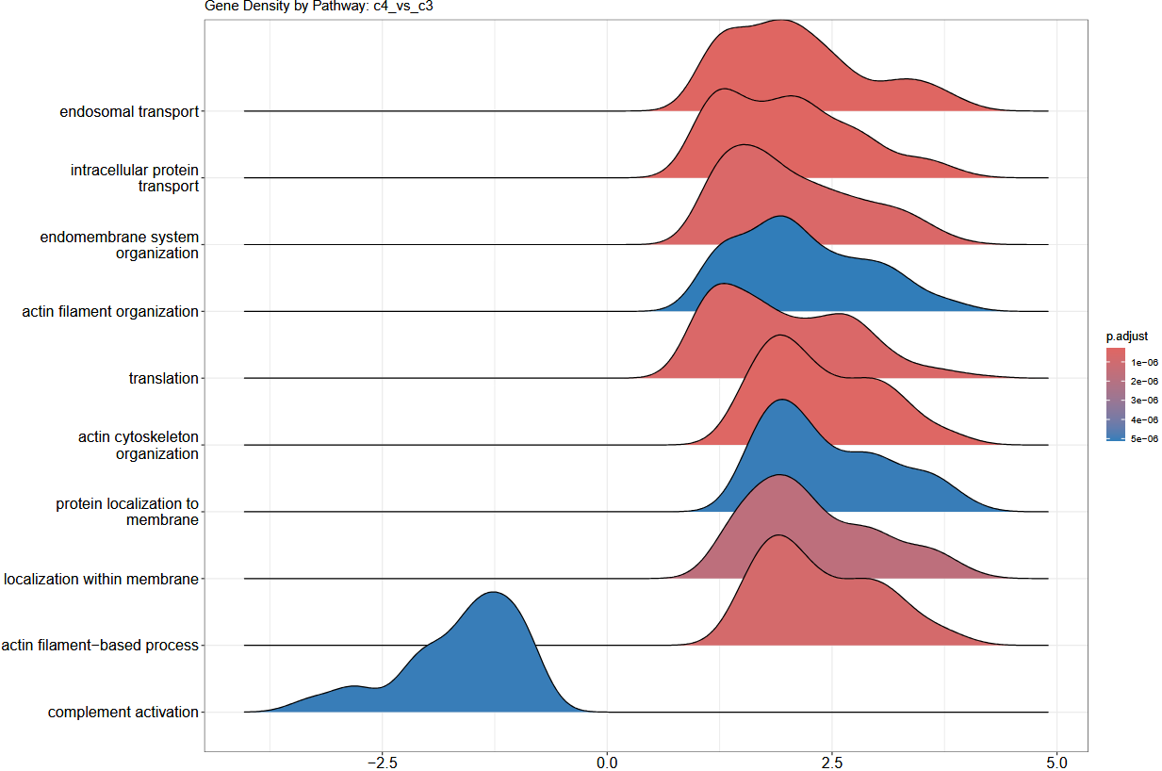
Pathway analysis of Psychotic disorders vs Depressive disorders
18 DA proteins (adj p-val <= 0.05 and |logFC| >= 0.5)
2 proteins upregulated in Depressive disorders and 16 proteins upregulated in Psychotic disorders
Pathways where most proteins are upregulated in Psychotic disorders:
Endosomal transport (2 peaks)
Intracellular protein transport (2 peaks)
Endomembrane system organization (2 peaks?)
Actin filament organization (2 peaks)
Translation (2 peaks)
Actin cytoskeleton organization (2 peaks)
Protein localization to membrane (2 peaks)
Localization within membrane (2 peaks)
Actin filament-based process (2 peaks)
Pathway where most proteins are upregulated in Depressive disorders:
Complement activation (2 peaks)

Slide 26
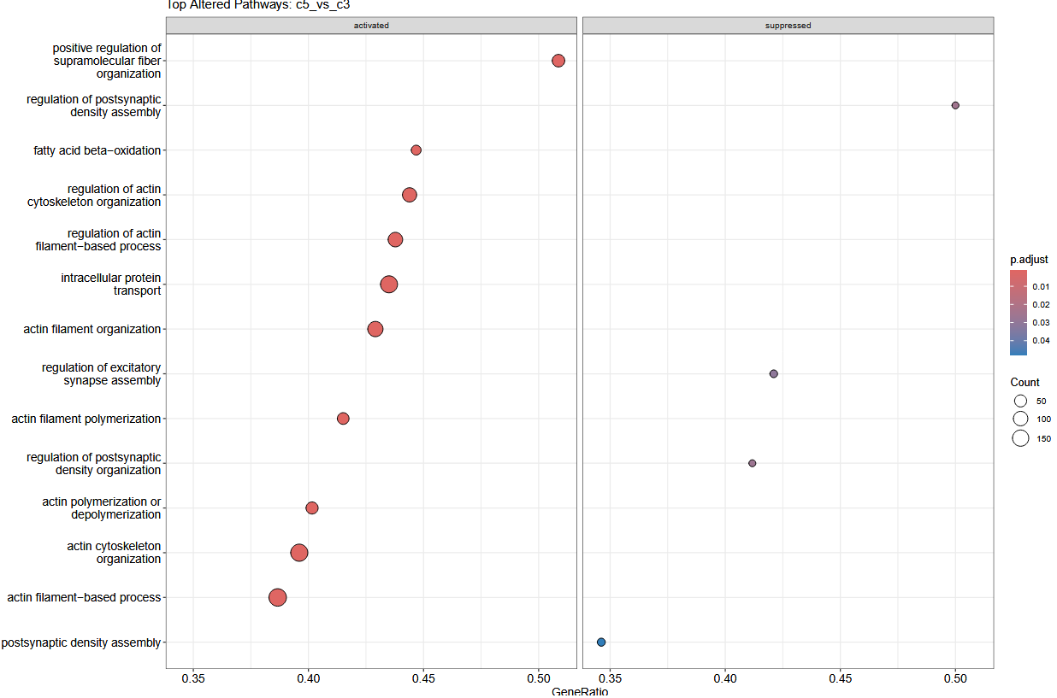
Pathway analysis of Schizophrenic disorders vs Depressive disorders
0 DA protein (adj p-val <= 0.05 and |logFC| >= 0.5)
Upregulated pathways in Schizophrenic disorders:
Positive regulation of supramolecular fiber organization
Fatty-acid beta-oxidation
Regulation of actin cytoskeleton organization
Regulation of actin filament-based process
Intracellular protein transport
Actin filament organization
Actin filament polymerization
Actin polymerization or depolymerization
Actin cytoskeleton organization
Actin filament-based process
Upregulated pathways in Depressive disorders:
Regulation of postsynaptic density assembly
Regulation of excitatory synapse assembly
Regulation of postsynaptic density organization
Postsynaptic density assembly

Slide 27
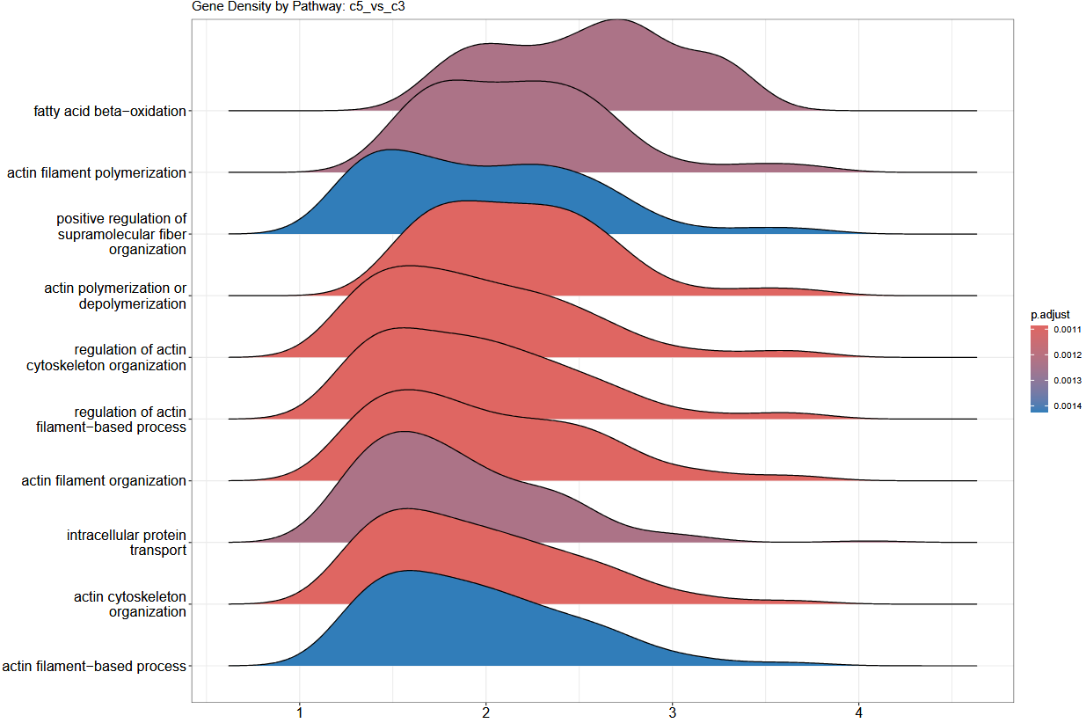
Pathway analysis of Schizophrenic disorders vs Depressive disorders
0 DA protein (adj p-val <= 0.05 and |logFC| >= 0.5)
Pathways where most proteins seem to be upregulated in Schizophrenic disorders:
Fatty acid beta-oxidation (3 peaks)
Actin filament polymerization (2 peaks)
Positive regulation of supramolecular fiber organization (2 peaks)
Actin polymerization or depolymerization (2 peaks)
Regulation of actin cytoskeleton organization
Regulation of actin filament-based process
Actin filament organization (2 peaks)
Intracellular protein transport (2 peaks)
Actin cytoskeleton organization
Actin filament-based process

Slide 28
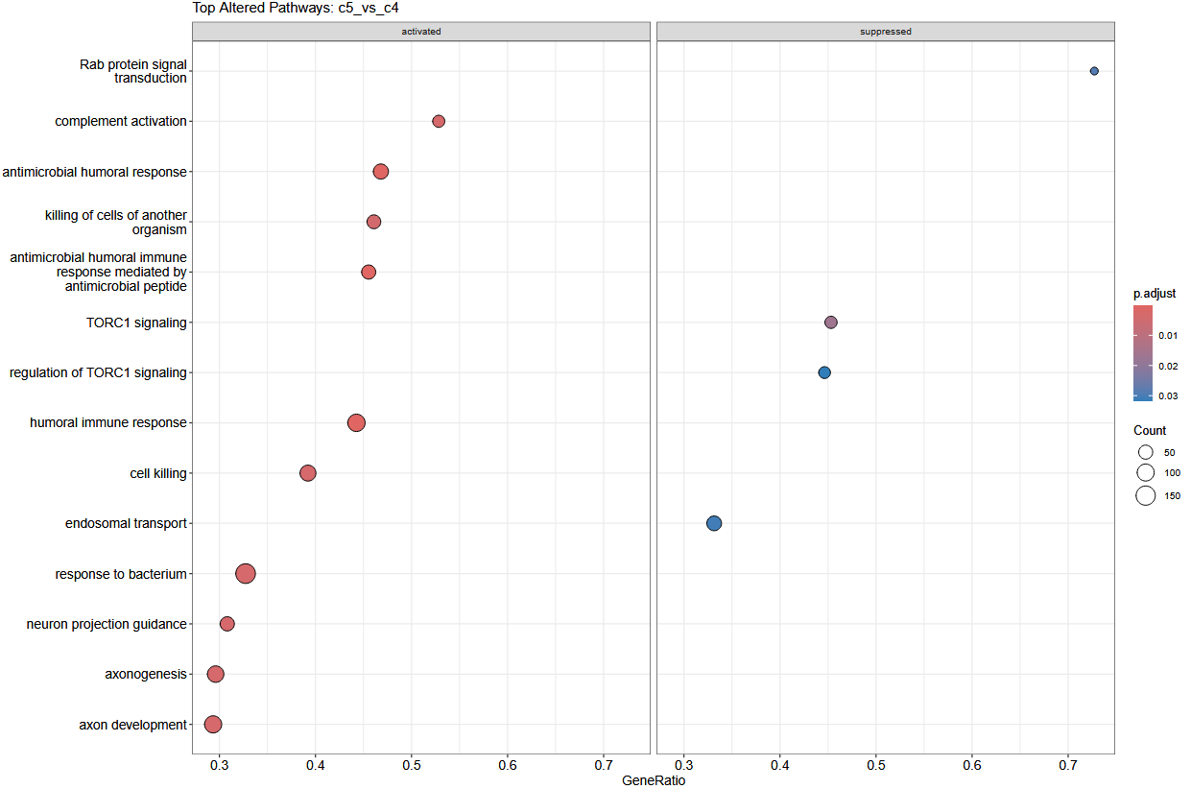
Pathway analysis of Schizophrenic disorders vs Psychotic disorders
2 DA proteins (adj p-val <= 0.05 and |logFC| >= 0.5)
1 protein upregulated in Psychotic disorders and 1 protein upregulated in Schizophrenic disorders
Upregulated pathways in Schizophrenic disorders:
Complement activation
Antimicrobial humoral response
Killing of cells of another organism
Antimicrobial humoral response mediated by antimicrobial peptide
Humoral immune response
Cell Killing
Response to bacterium
Neuron projection guidance
Axonogenesis
Axon development
Upregulated pathways in Psychotic disorders:
Rab protein signal transduction
TORC1 signaling
Regulation of TORC1 signaling
Endosomal transport

Slide 29
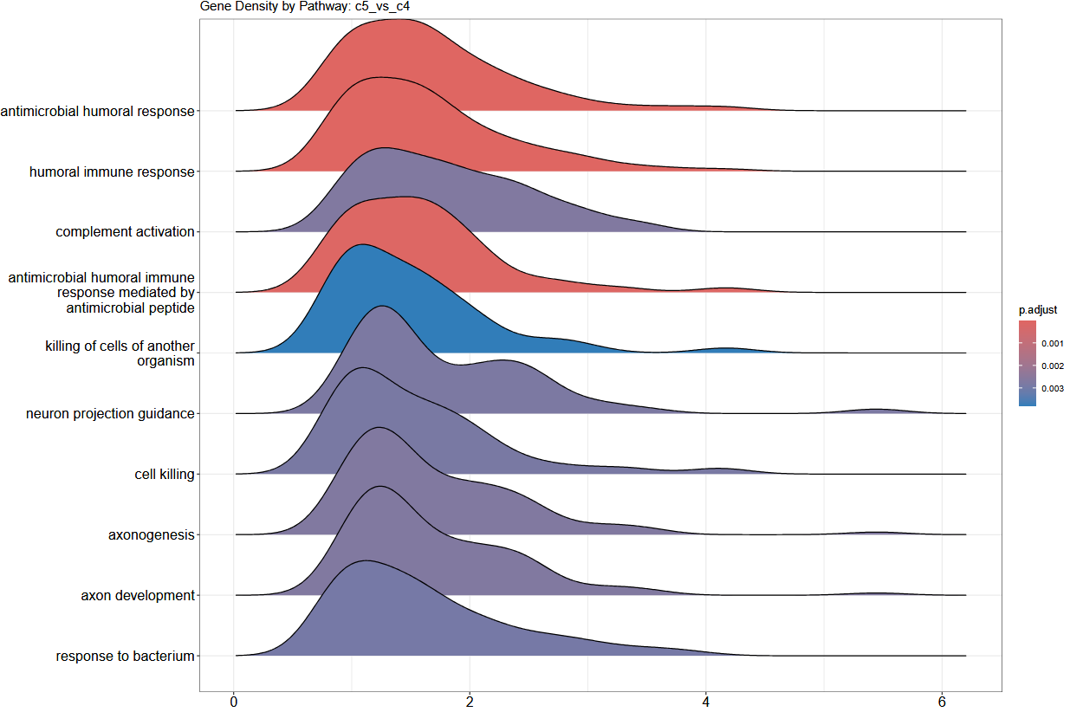
Pathway analysis of Schizophrenic disorders vs Psychotic disorders
2 DA proteins (adj p-val <= 0.05 and |logFC| >= 0.5)
1 protein upregulated in Psychotic disorders and 1 protein upregulated in Schizophrenic disorders
Pathways where most proteins seem to be upregulated in Schizophrenic disorders:
Antimicrobial humoral response
Humoral immune response
Complement activation (2 peaks?)
Antimicrobial humoral immune response mediated by antimicrobial peptide
Killing of cells of another organism (2 peaks?)
Neuron projection guidance (2 peaks)
Cell killing (2 peaks)
Axonogenesis (2 peaks)
Axon development (2 peaks)
Response to bacterium

Slide 30
Timeline & Deliverables

Slide 31
Budget Update
Current Budget:
Expected to run out end of May 2026
New SOW drafted and sent to Alessandra to extend spend w/ extra week of buffer for Akrivia analysis built-in.
Ask: If Akrivia provides updates to metadata or other analysis needed, can Joe confirm with Alessandra budget spend continues to be ok?
Corey: Can provide Alessandra/Joe with budget burndown if needed.

Slide 32
J&J: Akrivia Health SomaLogic Proteomics Analysis
Timeline
Today
2026
Feb
Mar
Feb 3 - Feb 9
5 days
Onboarding, Environment Setup, Data Import into Domino
2026
Feb 10 - Feb 13
4 days
Data Normalization & QC
Global Minds / Akrivia Proteomics Analysis
Feb 16 - Feb 23
6 days
Diff Abundance Analysis (DAA)
Feb 24 - Mar 3
6 days
Pathway Analysis
Mar 4 - Mar 9
4 days
Compare Treatment-Resistant Patients vs Reponders
Mar 10 - Mar 12
3 days
Correlate Proteomics Levels to Clinical Data
Mar 13 - Mar 16
2 days
Reporting & QC
Timeline
On-Boarding (4 hours)
Data Retrieval, Normalization, & QC (16 hours)
Differential Abundance Analysis (DAA) (24 hours)
Pathway Analysis (24 hours)
Compare treatment-resistant patients vs responders (16 hours)
Correlate proteomics levels to clinical data (12 hours)
Reporting & QC (8 hours)
Total: 104 hours Bioinformatics; 10 hours Project Management.

Slide 33
Archive

Slide 34
Action Items
Action Items from 17-Feb-2026 Meeting
Julie: Start on the DAA process – COMPLETED, 23-Feb-2026
Action Items from 10-Feb-2026-Feb Meeting
Julie: Start on the QC and normalization process – COMPLETED, 13-Feb-2026

Slide 35
Action Items
Action Items from 2026-Feb-03 Meeting
Joe: Provide access to the MS Teams folder with the clinical XLS files – COMPLETED, 2026-Feb-06
Farzad: Create a new Domino project and upload the proteomics data files for the analysis – COMPLETED, 2026-Feb-03
Corey: Setup weekly calendar cadence for the team to meet – COMPLETE, 2026-Feb-03

